Slide 1

HISTORY OF THE EMERGENCE OF INDEPENDENT BANGLADESH
Dr. Md. Abdul Alim
B. A (Hon’s), M. A (History), M. Phil (Raj), Ph. D (Raj)
Email:doctorabdulalim64@gmail.com
Cell: +880 01718-787466

Slide 2
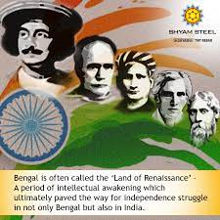
BENGAL RENAISSANCE
The Bengal Renaissance also known as the Bengali Renaissance, was a cultural, social, intellectual, and artistic movement that took place in the Bengal region of the British Raj, from the late 18th century to the early 20th century. Historians have traced the beginnings of the movement to the victory of the British East India Company at the 1757 Battle of Plassey, as well as the works of reformer Raja Rammohan Roy, considered the "Father of the Bengal Renaissance," born in 1772. Nitish Sengupta stated that the movement "can be said to have … ended with Rabindranath Tagore," Asia's first Nobel laureate.

Slide 3
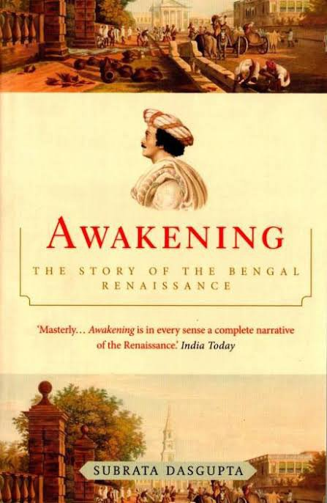
BENGAL RENAISSANCE
For almost two centuries, the Bengal Renaissance saw the radical transformation of Indian society, and its ideas have been attributed to the rise of Indian and colonialist and nationalist thought and activity during this period. The philosophical basis of the movement was its unique version of liberalism and modernity. According to Sumit Sarkar, the pioneers and works of this period were revered and regarded with nostalgia throughout the 19th and 20th centuries, however, due to a new focus on its colonialist origins, a more critical view emerged in the 1970s.

Slide 4
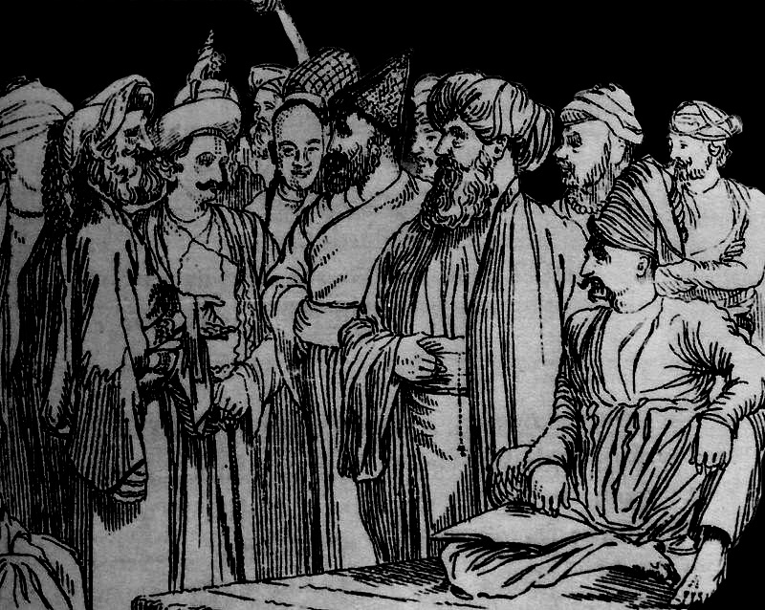
BENGAL RENAISSANCE
The Bengali renaissance was predominantly led by Bengali Hindus, who at the time were socially and economically more affluent in colonial Bengal, and therefore better placed for higher education as a community. Well-known figures include the social reformer Raja Rammohan Roy, writer Rabindranath Tagore, and the physicist Satyendra Nath Bose. The main Muslim figures in the movement include members of the Suhrawardy family, poet and musician Kazi Nazrul Islam, and writer Rokeya Sakhawat Hussain.

Slide 5
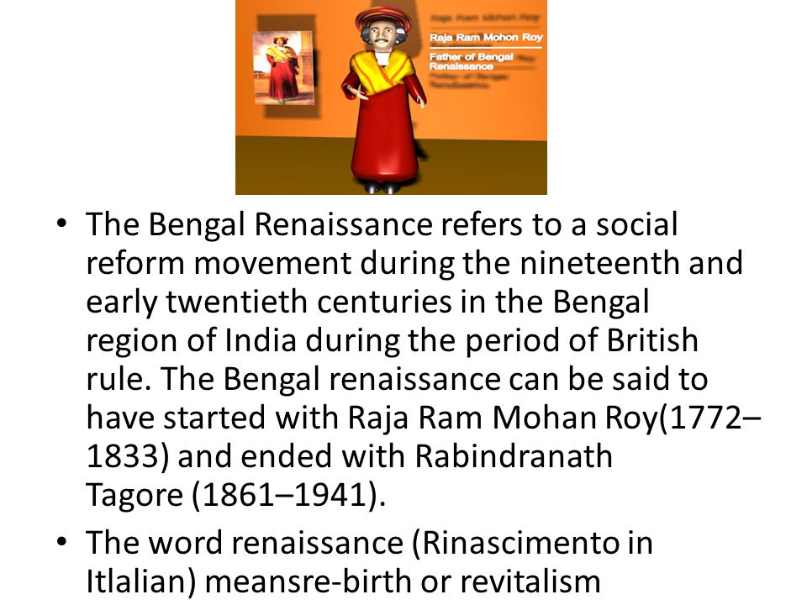
BACKGROUND
The Bengal Renaissance was a movement characterized by a sociopolitical awakening in the arts, literature, music, philosophy, religion, science, and other fields of intellectual inquiry. The movement questioned the existing customs and rituals in Indian society – most notably, the caste system, the practice of Sati, and idolatry – as well as the role of religion and colonial governance. In turn, the Bengal Renaissance advocated for societal reform – the kind that adhered to secularist, humanist, and modernist ideals. From Rabindranath Tagore to Satyendra Nath Bose, the movement saw the emergence of important figures, whose contributions still influence cultural and intellectual works today.

Slide 6
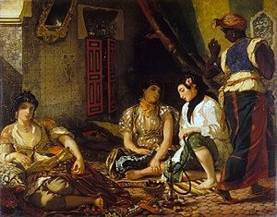
IMPACT OF RENAISSANCE ON BENGALI SOCIAL LIFE
Beginning and Development of Bengali Renaissance in the Nineteenth Century. This renaissance had a special impact on the Bengali society at that time. Superstition, various reforms, and classical rules were very prominent in ancient and medieval Bengal society. In the reawakened Bengali psyche, faith in humanism, scientific judgment, and inspiration of conscience took their place. This renaissance led to a movement against social and religious prejudices. Rather than the concept of heaven, hell, or God, Renaissance archetypes tended to favor anthropocentric thinking.

Slide 7
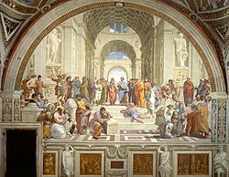
INFLUENCE OF BENGALI RENAISSANCE ON EDUCATION
Among the many changes brought about by the Bengal Renaissance in India was the development of education, both in the Bengali language and in English. Colonial provisions at the time consisted mainly of village schools teaching literacy and numeracy, Arabic and Islamic studies being taught to Muslims in madrasas, and tools, where pandits instructed Sanskrit texts to Brahmins, which were supported by endowments. These institutions were exclusively male, and in the rare cases where girls could get an education, it was in the home. The work of Christian missions also had more of an influence on Indian students than the initiatives of the government.

Slide 8
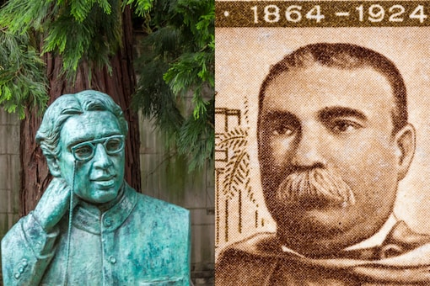
INFLUENCE OF BENGALI RENAISSANCE ON SCIENCE
During the Bengal Renaissance science was also advanced by several Bengali scientists such as Satyendra Nath Bose, Ashutosh Mukherjee, Anil Kumar Gain, Prasanta Chandra Mahalanobis, Prafulla Chandra Ray, Debendra Mohan Bose, Jagadish Chandra Bose, Jnan Chandra Ghosh, Gopal Chandra Bhattacharya, Kishori Mohan Bandyopadhyay, Jnanendra Nath Mukherjee, Sisir Kumar Mitra, Upendranath Brahmachari, and Meghnad Saha. Jagadish Chandra Bose (1858–1937) was a polymath. a physicist, biologist, botanist, archaeologist, and writer of science fiction. He pioneered the investigation of radio and microwave optics, made very significant contributions to botany, and laid the foundations of experimental science in the Indian subcontinent. He is considered one of the fathers of radio science and is also considered the father of Bengali science fiction. He also invented the Cresco graph.

Slide 9
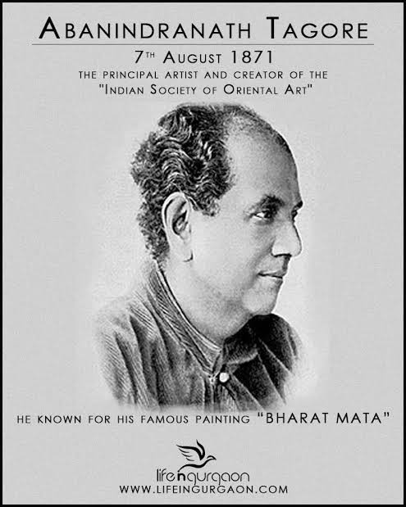
INFLUENCE OF BENGALI RENAISSANCE ON ARTS
The Bengal School of Art was an art movement and a style of Indian painting that originated in Bengal and flourished throughout British India in the early 20th century. Also known as the 'Indian style of painting' in its early days, it was associated with Indian nationalism (swadeshi) and led by Abanindranath Tagore.
Following the influence of Indian spiritual ideas in the West, the British art teacher Ernest Binfield Havell attempted to reform the teaching methods at the Calcutta School of Art by encouraging students to imitate Mughal miniatures. This caused controversy, leading to a strike by students and complaints from the local press, including from nationalists who considered it to be a retrogressive move. Havell was supported by the artist Abanindranath Tagore.

Slide 10
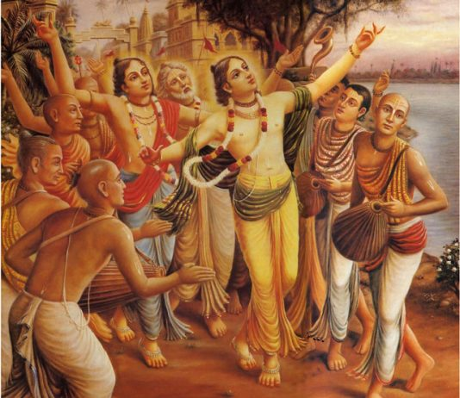
INFLUENCE OF BENGALI RENAISSANCE ON LITERATURE
According to historian Romesh Chunder Dutt: The conquest of Bengal by the English was not only a political revolution but ushered in a greater revolution in thoughts and ideas, religion and society ... From the stories of gods and goddesses, kings and queens, princes and princesses, we have learned to descend to the humble walks of life, to sympathize with the common citizen or even common peasant … Every revolution is attended with vigor, and the present one is no exception to the rule.

Slide 11
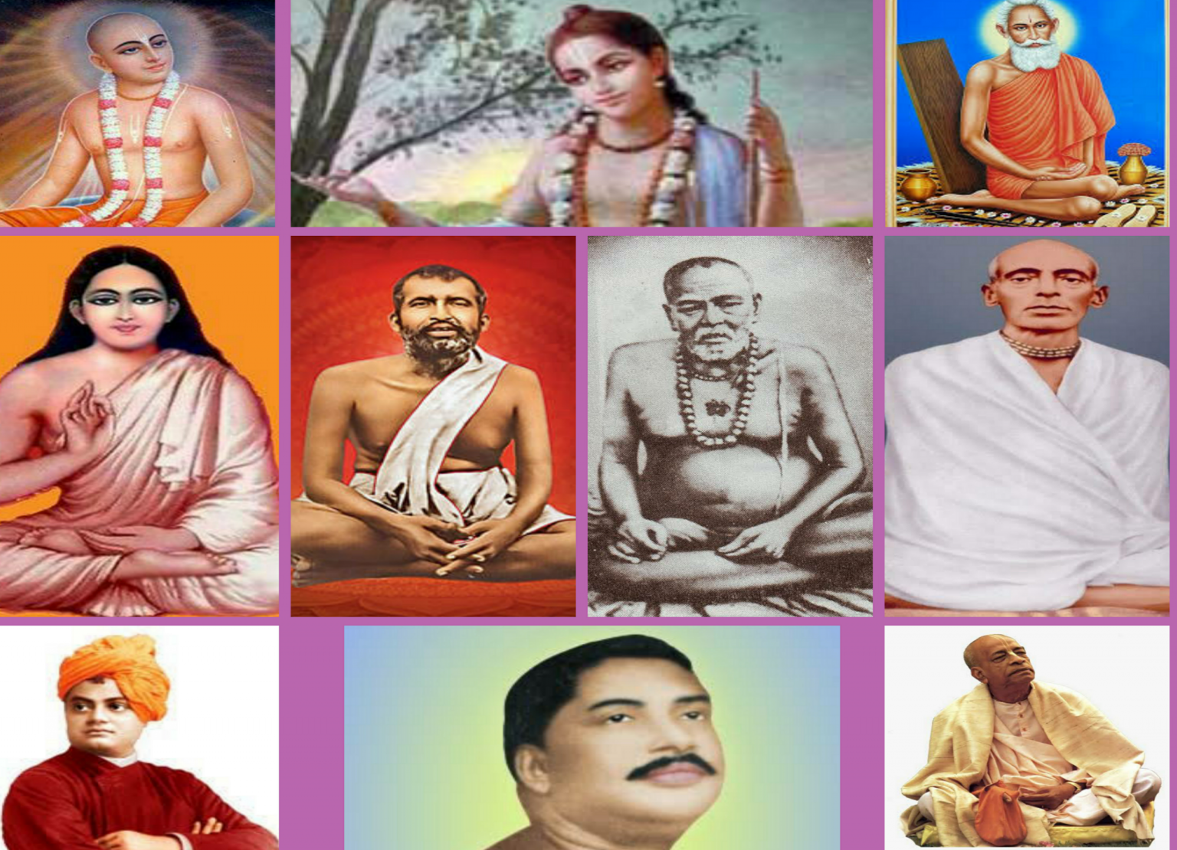
INFLUENCE OF BENGALI RENAISSANCE ON RELIGION AND SPIRITUALITY
The Bengali Renaissance also led to religious reform movements. Some notable religious and spiritual leaders associated with these reform movements are Ram Mohan Roy, Debendranath Tagore, Keshab Chandra Sen, Bijoy Krishna Goswami, Ramakrishna, Sarada Devi, Swami Vivekananda, Aurobindo, Bamakhepa, Lokenath Brahmachari, Bhaktisiddhanta Sarasvati, Bhaktivinoda Thakur, Paramahansa Yogananda, Lahiri Mahasaya, Tibbetibaba, Nigamananda Paramahansa, Vishuddhananda Paramahansa, Ram Thakur, Sitaramdas Omkarnath, and Anandamayi Ma.

Slide 12
THE FAKIR-SANNYASI REVOLT 1760 AND 1800
The Sannyasi rebellion or monk rebellion 1770-77 (The monks' rebellion) was a revolt by the sannyasis and sadhus (Hindu ascetics, respectively) in Bengal, India in the late 18th century which took place around Murshidabad and Baikunthapur forests of Jalpaiguri under the leadership of Pandit Bhabani Charan Pathak. While some refer to it as an early war for India's independence from foreign rule, since the right to collect tax had been given to the British East India Company after the Battle of Buxar in 1764, other historians categorize it as acts of violent banditry following the depopulation of the province in the Bengal famine of 1770.
In 1771, 150 saints were put to death, apparently for no reason. This was one of the reasons that caused distress leading to violence, especially in Natore in Rangpur, now in modern Bangladesh. However, some modern historians argue that the movement never gained popular support.

Slide 13
CLASHES BETWEEN THE COMPANY AND ASCETICS
The other two movements involved a sect of Hindu ascetics, the Dasnami naga sannyasis who likewise visited Bengal on pilgrimage mixed with moneylending opportunities. To the British, these ascetics were looters and must be stopped from collecting money that belonged to the company and possibly from even entering the province. It was felt that a large body of people on the move was a possible threat.
Clashes between the Company and ascetics:
From hundreds of years monks had been visiting North India and pilgrim sites. They also used to take some alms from zamidars. But after British imposed taxes on zamidars, it became hard for them to give alms to the ascetics. Sannyasis & Fakirs were burden with restrictions as the British government thought they were looters & thugs. And thus rebellion began. Most of the clashes were recorded in the years following the famine but they continued, albeit with a lesser frequency, up until 1802. The reason that even with superior training and forces, the company was not able to suppress sporadic clashes with migrating ascetics was that the control of the company's forces in the far-removed hilly and jungle covered districts like Birbhum and Midnapore on local events was weak.

Slide 14
EARLY EVENTS THE FAKIR-SANNYASI REVOLT
At least three separate events are called the Sannyasi Rebellion. One refers to a large body of Hindu sannyasis who travelled from North India to different parts of Bengal to visit shrines. En route to the shrines, it was customary for many of these ascetics to exact a religious tax from the headmen and zamindars or regional landlords. In times of prosperity, the headmen and zamindars generally obliged. However, since the East India Company had received the diwani or right to collect tax, many of the tax demands increased and the local landlords and headmen were unable to pay both the ascetics and the English. Crop failures, and famine, which killed ten million people or an estimated one-third of the population of Bengal compounded the problems since much of the arable land lay fallow.
In the Eighteenth Century Pandit Bhavanicharan Pathak was the main hero of the 'Sannyasi Rebellion' against the British rule and exploitation in the land of Bengal. Sannyasi Rebellion was India's first anti-British independence struggle.

Slide 15
EARLY EVENTS THE FAKIR-SANNYASI REVOLT
The Sannyasi rebellion was the first of a series of revolts and rebellions in the western districts of the province including (but not restricted to) the Chuar Revolt of 1799 and the Santhal Revolt of 1855–56. What effect the Sannyasi Rebellion had on rebellions that followed is debatable. Perhaps, the best reminder of the Rebellion is in literature, in the Bengali novels Anandamath (1882) and Devi Chaudhurani (1884), written by India's first modern novelist Bankim Chandra Chatterjee. The song, Vande Mataram, which was written in 1876, was used in the novel Anandamath in 1882 (pronounced Anondomôţh in Bengali) and the 1952 movie based on the book. The first two verses of Vande Mataram were later declared to be India's National Song (not to be confused with the Indian National Anthem).
In 2022, Telugu film producer and scriptwriter V. Vijayendra Prasad announced his upcoming project tentatively titled 1770: Ek Sangram, based on Anandamath and the Sannnyasi rebellion. The movie will be simultaneously made in Bengali, Hindi, Tamil and Telugu.

Slide 16
THE RANGPUR REVOLT OF 1783 & BACKGROUND:
Peasant Movement In 19th Century – Rangpur Dhing
Rangpur Dhing is called the first tough peasant against the British East India Company rule. The Rangpur Dhing uprising took place in Bengal.Diwani gave rights to Britishers in 1765 and five years of settlement in 1767 which led to the exploitation of the peasants. The movement was a result of the exploitation of the Britishers which led to mass uprising against colonial rule.
Background:
The background of the Rangpur Dhing is described as follows:
The peasants themselves on their own initiative offered resistance to British rule. The Rangpur rebellion took place in 1783 in the Northern districts of Bengal is an ideal example of such opposition.

Slide 17
THE RANGPUR REVOLT OF 1783
The acquisition of the right to collect Bengal’s territorial revenues in 1765 presented the East India company with access to a potentially vast source of wealth.
Company officials attempting to fully exploit this revenue bearing territory brought into violent conflict with the overburdened population. This can be seen in the Dhing or the peasant rebellion which took place in the Northern district of Rangpur in 1783.
After the acquisition of the Diwani, the first objective of the company was to raise a large sum of money from the country as far as it is possible to collect.

Slide 18
THE RANGPUR REVOLT OF 1783
In January 1767, Henry Verelst became the Governor of Bengal who observed that in the period following the acquisition of Diwani where there had been oppression and intrigues which were unknown at the other period.
During the years of the Diwani,the Rangpur district was overburdened with very large demands.
The five years settlement was introduced in 1772 which was already in a languishing condition.
The rate assessment was further increased.
The district collector admitted that it was beyond the capacity of the district to bear the increased burden.

Slide 19
THE RANGPUR REVOLT OF 1783
The five year settlement was proved to be a failure by the year 1777. So the company insisted on annual settlements which is the system they had condemned earlier. Another period of indecisive experiments was followed till the permanent settlement was introduced.
A European collector operated in Tandem with an Indian revenue farmer who is also known as Ijardar, had been contracted to pay a set amount of tax to the company and his profit lay in any surplus he could extort from his cultivators.
For the collector, a district posting provided considerable opportunity to get the benefit from illicit private trade and the misappropriation of government funds.

Slide 20
THE RANGPUR REVOLT OF 1783
In the early days of the revenue farming system, the peasantry was oppressed by the revenue contractors and the company officials imposing high revenue demands and often collecting illegal cesses.
Rangpur became the scene of a formidable Peace and Revolt in 1783. It was caused by a gross act of provocation from the land revenue farmer or the Ijardar.
To enforce payment of the heavy demand of the farmer,all sorts of compulsion were employed against the zamindars.
The zamindars passed on their burden to the rights as the demands and the exacts of the farmer increased.

Slide 21
THE RANGPUR REVOLT OF 1783
The ryots stated in a mass petition ” We raiyats are ruined. In our house we have nothing left, our grain, our cattle, and other effects we have sold.”
Debi Singh or Gangagobinda Singh was the worst offenders who were revenue contractors, had unleashed a reign of terror in the villages of Rangpur and Dinajpur district.
Debi singh who was appointed ijardar of Rangpur and Dinajpur in 1780 practiced untold all severity to release all the revenue.
The immediate cause of this rising was the large-scale disposal of the agricultural holdings of the defaulting rights at the nominal price. As the petition was sent to Goodland who was the chief of the district failed to produce any relief which resulted in the ryots to take the laws into their own hand.

Slide 22
THE RANGPUR REVOLT OF 1783
Peasant Movement In 19th Century ( Rangpur Dhing ) – Causes:
The causes of the Rangpur Dhing are described as follows:
The East India Company had a motive of squeezing out maximum revenue from the peasants.
During that time, the ijaradari system was in place according to which the ijardar or the izaredar who is a revenue farmer, contracted by the company to pay revenue that was fixed either annually or every 5 years on a piece of land. The company would give the land to the highest bidder and then he became the ijardar.
Izardar was not interested in the welfare of the farmers who cultivated the land under him or in the development of the land.

Slide 23
THE RANGPUR REVOLT OF 1783
Ijardar’s main aim was to squeeze out maximum revenue from the farmer so that he would be able to pay the company and also earn some profit for himself.
Agrarian economy suffered a lot under the various ‘experiments’ done by the British on the land revenue system. Famines became commonplace and rural indebtedness surged. The farmers also became mired in deep poverty.
The tax rates were so high that the farmers were not able to pay the revenue.
The zamindars suffered under the system since the revenue demands were placed on him and he stood to lose his zamindari if he defaulted.
The ijardars resorted to the oppressive means to extract the highest revenue. Debi Singh was the ijardar of Rangpur and Dinajpur was especially severe.

Slide 24
THE RANGPUR REVOLT OF 1783
Peasant Movement In 19th Century ( Rangpur Dhing ) – The Uprising:
The uprising of the Rangpur Dhing are given as follows:
Debi Singh who was the Ijardar of Rangpur and Dinajpur practiced extremely harsh measures against the peasants.
The peasant Sent a petition to the company asking for the relief but it did not result in any heed to the farmers grievances. This angered the farmers who ended up taking things into their own hands.
The Rangpur Dhing uprising was started on January 18, 1783 when the peasants and the Zamindars took control of the Parganas of Kakina, Kazirhat and Tepa in the district of Gangapur.

Slide 25
THE RANGPUR REVOLT OF 1783
They attacked the courts, looted grains and released the Prisoners. For five weeks all these areas were under the control of the rebels who appointed a nawab and other officials for running a parallel government.
Kena Sarkar was one of the Main leaders of the revolt.
All the revenue payment through the company was forbaded.
The uprising was spread to Dinajpur also.
However, the uprising was put down by the British and many of the rebels were killed.

Slide 26
THE RANGPUR REVOLT OF 1783
Peasant Movement In 19th Century (Rangpur Dhing) – Effects:
The effects of the Rangpur Dhing rebellion is given as follows:
The uprising helps in bringing the weakness of the ijaradari system in light.
Though all the rebellion was suppressed, the Government brought some of the reforms in the farming system.
This helped in paving the way for a more permanent system of land revenue.
This Rangpur Dhing rebellion saw unity between the Hindus and Muslims.

Slide 27
THE BALAKI SHAH REVOLT
Balaki Shah a fakir who resisted company rule in Bakarganj in 1792. Balaki Shah was a resident of mouza Bakhari under Salimabad pargana of Bakarganj district. The closing years of eighteenth century Bengal-the period of chronic scarcities, rack-renting and administrative instabilities-are characterised by sporadic local peasant resistance movements.

Slide 28
THE BALAKI SHAH REVOLT
Balaki Shah';s followers, who were all cultivators, felt oppressed by the ever rising revenue demands and oppressive mode of their collection. Being unable to get any relief from the authorities, the oppressed peasantry looked to Balaki Shah, their murshid (guide), for justice. Balaki organised a resistance force of one thousand armed men and established a fort at Subania. For defence purposes he also repaired the old Sujabad fort, earlier built by shah shuja.

Slide 29
THE BALAKI SHAH REVOLT
Balaki Shah';s resistance activities had twofold aims of driving out the Europeans from Bakarganj and rescuing the oppressed raiyats from the misrule of the company. In realising these two objectives, Balaki Shah declared independence of company rule in 1792 and installed one Jeon, presumably his mentor, as sultan. He proclaimed the end of the Firingi hukumat. He compelled all the zamindars of pargana Salimabad, Nazirpur and Chandradvip to renounce the company authority and acknowledge him as their new ruler and pay revenue to him.

Slide 30
THE BALAKI SHAH REVOLT
In order to win the peasantry over to him and also to substantiate his sovereignty, Balaki Shah announced a new rate of rent, which was far below the existing rate. He ordered the zamindars not to charge more than two rupees per kani (120 decimals) and refund to the raiyats if any excess had been collected already. Defaulting zamindars were threatened with severe punishment.

Slide 31
THE BALAKI SHAH REVOLT
Balaki Shah and his followers initially succeeded in ousting the company barkandajes from the area. Many zamindars fled away from their estates. To bring the situation under control, the Bakarganj collector sent a detachment of sepoys under the command of European officers who stormed Balaki's mud fort and captured him. He was tried in the Dhaka Nizamt Adalat, which found him guilty of rebellion and bloodshed and sentenced him to seven years imprisonment.

Slide 32
AGA MOHAMMAD REZA REVOLT 1799
Reza was a Sufi pir, which enabled him to have the support of thousands of peasants, fakirs and ryots. It is said that he also gained support from Shams ud-Daulah, the Naib Nazim of Dhaka. He made an announcement calling for jihad against the British colonial rulers, who he preached were the reasons behind the problems that the peasants were facing.

Slide 33
AGA MOHAMMAD REZA REVOLT 1799
In 1799, Reza marched with his followers from Sylhet to the western frontiers of the Kachari Kingdom. Referred to as his "hijrat", it is assumed that Reza planned to gather a larger following and secure a stronghold at Khaspur before facing the British in a war. Claiming to be the Mahdi (promised messiah) and twelfth imam, he promised to free the natives from oppression. Reza conspired with the local Naga and Kuki tribes, who were allied with the Kachari Raja Krishnachandra Narayan, and was able to convince them to join his side.

Slide 34
AGA MOHAMMAD REZA REVOLT 1799
Raja Krishnachandra deployed several barqandaz (subalterns) to defeat Reza but they were all defeated by the large force, and he was subsequently expelled by Reza from his capital at Khaspur. In defeat, Krishnachandra fled to the nearby hills of northern Cachar, and some of his Hindus subjects were said to have gone into hiding in the forests of Cachar or migrated to Sylhet in fear of oppression. According to legend, Krishnachandra wrote many folk songs and poems during his hiding in the hills of northern Cachar.

Slide 35
THE CHAKMA MOVEMENT OF 1777-87
The Chakma Movement of 1777-87 was an armed resistance movement launched by the Chakma people against the East India Company and the British government. The movement was a response to the Company's attempt to impose its rule on the Chakma Kingdom, which had been an independent state until then.
The Chakma Kingdom was located in the hilly regions of present-day Bangladesh, India, and Myanmar. It was ruled by the Chakma dynasty, which had a complex system of governance and a rich cultural heritage. However, the Company saw the Kingdom as a valuable addition to its expanding empire and began to encroach upon its territory.

Slide 36
THE CHAKMA MOVEMENT OF 1777-87
In 1777, the Company established a military outpost in the Kingdom, which sparked widespread protests among the Chakma people. The protests soon turned into armed resistance, and the Chakma Movement was born. The movement was led by the Chakma king, Raja Jan Baksh, who rallied his people to fight for their independence and their way of life.
The Chakma rebels launched several attacks on the Company's military outposts, and although they were outnumbered and outgunned, they managed to inflict significant losses on the British forces. The movement also received support from other ethnic groups in the region, such as the Tripuris and the Marmas.

Slide 37
THE CHAKMA MOVEMENT OF 1777-87
However, the Chakma Movement was eventually crushed by the Company's superior military might. In 1787, the Chakma king was captured and executed, and the Kingdom was annexed to the Company's territories. The Chakma people were subjected to various forms of exploitation and oppression under British rule, including forced labor, land expropriation, and religious persecution.
The legacy of the Chakma Movement lives on, however, as a symbol of resistance against colonialism and imperialism. The movement inspired other ethnic groups in the region to rise up against the Company's rule, and it also paved the way for the emergence of nationalist movements in the region in the following decades.

Slide 38
PAGAL PANTHI MOVEMENT (1825-1833)
Pagal Panthi Movement (1825-1833) a peasant movement guided by religious medicants called Pagal Panthis. At the initial stage it was directed against the zamindars and later assumed the character of an anti-British movement.
Northern Mymensingh including Sherpur was different from Bengal proper in many ways. Its language, culture and ethnic traits were basically dominated by the hill tribes: the Garos, Hajangs, Dalus, Hudis and the Rajvangshies. Nature worship was their main faith. In course of time Hindu and Muslim elements were also added to their culture and the area began to be inhabited by some Hindus and Muslims as well. For decades the region provided a safe-haven for religious and political rebels. The Pagal Panthis belonged to this category.

Slide 39
PAGAL PANTHI MOVEMENT (1825-1833)
Karim Shah was the founder of the Pagal Panthi sect. He is said to have been a disciple of Musa Shah, a companion of Fakir majnu shah. Probably a Pathan by origin, Karim Shah started living in a village named Letarkanda in the Sushang pargana of northern Mymensingh apparently from 1775 and interpreted Islam in a popular way keeping in mind the local customs and traditions. His teachings attracted people irrespective of race and religion and Muslims, Hindus and nature worshippers were among his disciples.

Slide 40
PAGAL PANTHI MOVEMENT (1825-1833)
The teachings of Karim Shah were easy and simple. He taught that God created mankind. So they are all equal and brethren to each other. His followers, therefore, addressed each other as 'Bhai-Saheb'. Their behaviour and way of life seemed unusual and peculiar to the people living in the plains. Bhai-Sahebs thus came to be called 'Pagals' (mad-caps) by the people in the plains and the activities and propagations of Karim Shah and his followers came to be known as the 'Pagal Panthi Movement'. The ideas of the Pagal Panthis had been formed incorporating the non-violent elements of all religions and were consistent with the traditional faiths of the peasantry.
Karim Shah was believed to be endowed with spiritual power. According to his followers, he could foretell and cure diseases and bring success to them. The crowds gathered round him in flocks.

Slide 41
PAGAL PANTHI MOVEMENT (1825-1833)
Karim Shah died in 1813. His son tipu shah alias Tipu Pagal succeeded him to the gadi (seat) of the Pagal Panthis. Under him the character of the movement greatly changed. It took the form of a peasant movement. The Pagals and their associates fought against the zamindars and the forces of the company to protect the peasants from the oppressions and undue claims of the zamindars. Tipu Shah and some of his insurgent followers were captured in 1833 and tried. The government mitigated many of the demands of the resisting peasants, including reduction of rent rate. Consequently, the movement subdivided and peace was restored in the area.
After Tipu Shah (d 1852) Janku Pathor and Dobraj Pathor took the leadership of the Pagals and organised another resistance movement against zamindari oppression. They gave stiff resistance to the authority. They entered Sherpur town, looted the zamindari and revenue offices and captured and burnt the arms in the police station. The rebels declared themselves rulers of the area. The zamindars, government officials and the police took shelter at Mymensingh. For a time it appeared that the company government had ceased to exist. But peace was eventually restored by giving concessions to them in rent rate.

Slide 42
TITUMIR REVOLT OF 1831
The Wahabi movement enjoyed a special status in the history of revolt against British rule in India, and Titu Mir, whose real name was Syed Mir Nisar Ali, added militancy to it. It became the source of inspiration for several movements in the Struggle for Independence of India.
Titu Mir was born in a peasant family in 1782 at Hyderpur village, Narkelbaria paragana of West Bengal. Syed Mir Hasan Ali, Abida Roqayya Khatun were his parents. He was a renowned wrestler during his younger age and was engaged in several petty jobs. Syed Mir Nisar Ali went on a pilgrimage to Makkah in 1822 and met the founder of the Wahabi movement, Syed Ahmed Barelwi and the founder of the Farazi movement, Haji Shariatullah. The meeting of the three leaders had strengthened the ‘Wahabi-Farazi’ movements.

Slide 43
TITUMIR REVOLT OF 1831
After his return from Makkah, he settled in Hyderpur. He travelled extensively and saw the atrocities of the officials of the East India Company, Zamindars and Mahajans. Syed Mir Nisar Ali witnessed the woes of the people who suffered in the clutches of these exploiters. Titu decided to put an end to the exploitation and undertook a campaign to arouse the people for a rebellion agains
He started an armed struggle against the British Police and East India Company armed forces, who were supporting Zamindars and Mahajans. Zamindars and their men were collecting taxes for wearing beards and harassed Muslims. Opposing the oppressive taxes levied by the Company rulers and inhuman activities of local Zamindars, Titu Mir himself personally led several revolts. Titu Mir was irked by atrocities and attacks on the common people by Zamindars, Mahazans and British force. t the foreign rulers along with his spiritual campaign.

Slide 44
TITUMIR REVOLT OF 1831
Syed Mir Nisar Ali was so courageous that he was even informing the East India Company officials and police about his attacks in advance. His courageous approach attracted the poor towards him. Thousands of people, irrespective of religious and class barriers, followed him in his rebellion and fought for him against the police and British forces.
Titu Mir built a bamboo fort in Narkelbaria where he trained his followers in armed struggle and frightened the Company rulers for about a decade.
The British commanders attacked the fort of Syed Mir Nisar Ali (Titu Mir) on 19 November 1831 at Narkelbaria, where he succumbed to injuries in 1832.

Slide 45
THE FARAIZI MOVEMENT
The Faraizi movement was widely received in the districts of Dhaka, Faridpur, Barisal, Mymensingh and Comilla.
Some Muslims, on the other hand, particularly the landlords of Dhaka, hence, reacted sharply against him, which caused a riot in Nayabari, Dhaka District. Due to the reaction of these landlords and Hindu landlords and European indigo planters, this movement swelled into a socio-economic issue.
The landlords levied numerous abwabs (plural form of the Arabic term bab, signifying a door, a section, a chapter, a title). During Mughal India, all temporary and conditional taxes and impositions levied by the government over and above regular taxes were referred to as abwabs. More explicitly, abwab stood for all irregular impositions on Raiyats above the established assessment of land in the Pargana. Such abwabs were horribly dishonest in the eye of law. Several abwabs were of a religious nature. Haji Shariatullah then intervened to object to such a practice and commanded his disciples not to pay these dishonest cesses to the landlords. The landlords even inflicted a ban on the slaughter of cows, especially on the occasion of Eid. The Faraizis ordained their peasant followers not to obey such a ban. All these heated instances added up to tensed and stressed relationships amongst the Faraizis and the landlords, who were all Hindus.

Slide 46
THE FARAIZI MOVEMENT
The Islamic-led Faraizi movement could be witnessed in various parts of Bengal, with overwhelming Anglo-Bangla agreement for perhaps the very first time. The outraged landlords built up a propaganda campaign with the British officials, incriminating the Faraizis with a mutinous mood. In 1837, these Hindu landlords indicted Haji Shariatullah of attempting to build up a kingdom of his own. They also brought several lawsuits against the Faraizis, in which they benefitted dynamic co-operation of the European indigo planters. Shariatullah was placed under the detention of the police in more than one instance, for purportedly inciting agrarian turbulence in Faridpur.

Slide 47
THE FARAIZI MOVEMENT
After the death of Haji Shariatullah, his son, Dudu Miyan, led the movement to a more agrarian character. He organised the oppressed peasantry against the oppressive landlords. In retaliation, the landlords and indigo planters tried to contain Dudu Miyan by instituting false cases against him. However, he became so popular with the peasantry that in the cases, courts seldom found a witness against Dudu Miyan.
The initial victories of Dudu Miyan captured the imagination of the masses and Haji sahib the greta sought Dudu Miyan's protection against the oppressive landlords.

Slide 48
THE FARAIZI MOVEMENT
Dudu Miyan died in 1862 and before his death he had appointed a board of guardians to look after his minor sons, Ghiyasuddin Haydar and Abdul Gafur alias Naya Miyan who succeeded him successively. The board, with great difficulty, kept the dwindling movement from falling to pieces. It was not until Naya Miyan attained maturity that it regained some of its lost strength. Nabinchandra Sen, the then sub-divisional officer of Madaripur District, thought it prudent to enter into an alliance of mutual help with the Faraizi leaders, who, in their turn, showed a spirit of co-operation towards the government.

Slide 49
THE FARAIZI MOVEMENT
On the death of Naya Miyan in 1884, the third and the youngest son of Dudu Miyan, Syeduddin Ahmad was acclaimed leader by the Faraizis. During this time, the conflict of the Faraizis with the Taiyunis, another reformist group reached the climax and religious debates between the two schools of thought had become a commonplace occurrence in East Bengal. He was bestowed with the title of Khan Bahadur by the government. In 1905, on the question of the partition of Bengal, he lent support to Nawab Salimullah in favour of partition, but he died in 1906.

Slide 50
THE FARAIZI MOVEMENT
Khan Bahadur Syeduddin was succeeded by his eldest son Rashiduddin Ahmad alias Badshah Miyan. During the early years of his leadership, Badshah Miyan maintained the policy of co-operation towards the government. However, the annulment of the partition of Bengal made him anti-British and he took part in the Khilafat and non-co-operation movements. Soon after the establishment of Pakistan he summoned a conference of the Faraizis at Narayanganj and declared Pakistan as Dar-ul-Islam and gave permission to his followers to hold the congregational prayers of Jum'ah and Eid.

Slide 51
THE GREAT REVOLT OF 1857
The first war of independence was witnessed in the year 1857. This freedom struggle for the Indian citizens is considered one of the most defining moments. The East India Company’s Indian soldiers’ reaction to the new cartridge they had to use caused this series of events. The British government was seizing numerous states, kingdoms and taking land taxes. The displeasure caused by this tax became another chief reason behind the events that followed. People wanted to get rid of foreign rule and gain freedom from the British individuals.

Slide 52
CAUSE OF THE FIRST WAR OF INDEPENDENCE AGAINST THE BRITISH
The introduction of the Enfield rifle became the chief reason behind the triggering of the first war of independence. Before being loaded into the gun, the cartridge had to be removed. It was believed that the Indian soldiers greased the cartridge. They believed that the grease used was made from cow or pig fat. Harming these animals was against the sentiments of Muslim and Hindu individuals. The revolt of 1857 began from this point onwards. The Indian sepoys were enraged against the British due to the ‘Enfield’ rifle.

Slide 53
SOCIAL CAUSES OF THE FIRST WAR OF INDEPENDENCE AGAINST THE BRITISH
Economic reasons: the peasants were affected heavily by the reforms in the revenue system and the taxation. Several administrative policies were introduced and imposed by the British government to expand their territory.
Political cause: the unjust policies due to the British expansion caused the loss of power of the Zamindars and the Nawabs in various places across India. The unfair policies such as the policy of indirect subordination, Trade and Commerce, and the policy of war and annexation made the rulers the victims of expansion by the British.

Slide 54
WHY DID THE REVOLT OF 1857 COLLAPSE?
The revolt of 1857 began with the purpose of ousting the British from India, but the purpose remained unfulfilled due to the following reasons:
Three presidencies of Bombay, Madras, and Bengal remained unaffected for the most part. Northern India was affected majorly by this revolt.
No plan for after the defeat of the British was prepared by the leaders of the revolt of 1857. They did not envision any plan.
No coherent plan was followed for getting the British to leave India. Other than the lack of coherency, a single leader was lacking. This movement was followed by many leaders across different parts of India.

Slide 55
IMPACT OF THE REVOLT OF THE GREAT REVOLT OF 1857
The first war of independence against the British is considered one of the most important markings in Indian History. Let us go through the impact of this historical movement:
This revolt exposed the hollowness of the East India company’s rule in India. The British government decided to abolish the rule of the East India Company since it could not afford to lose India by hook or crook. After this, the British Parliament guided the direct government that was installed.

Slide 56
IMPACT OF THE REVOLT OF THE GREAT REVOLT OF 1857
The backbone of British rule in India was shaken to its roots due to the intensity of the revolt in 1857. Even though the revolt remained confined to smaller parts, the intensity caused by it was huge.
It proved that the East India Company was just a trading organisation that did not have the ability and efficiency to tackle the Indian administration.
The rule of East India Company in India for over 100 years marked the zenith of exploitation. The exploitation by the British marked all directions, that is, economic, political, and social.

Slide 57


